Slide 1
Final Project Presentation
Group 2:
Shiyu FAN (Leo)
Runhai XU (James)
Zhaohang YAN (Martin)

Slide 2
Overview
Problem we focus: Diagnose Brain Tumor/ Brain Cancer
User Interface: Interactive medical chatbot
Image classification algo: YOLOv3-Fastest
User upload images using medical chatbot
Medical chatbot with gTTS can communicate the diagnoses result

Slide 3

Diagnose Brain Tumor
If it's suspected that you have a brain tumor, your doctor may recommend a number of tests and procedures, including:
A neurological exam
Imaging tests. Magnetic resonance imaging (MRI) is commonly used to help diagnose brain tumors. Sometimes other imaging tests are recommended, including computerized tomography (CT). Positron emission tomography (PET) may be used for brain imaging, but is generally not as useful for creating images of brain cancer as it is for other types of cancer.
Tests to find cancer in other parts of your body. If it's suspected that your brain tumor may be a result of cancer that has spread from another area of your body, your doctor may recommend tests and procedures to determine where the cancer originated. One example might be a CT or PET scan to look for signs of lung cancer.
Collecting and testing a sample of abnormal tissue (biopsy)

Slide 4
User Interface (a medical bot)
Introducing our medical bot:
Users can upload their CT/MR scan to it
The bot will reply the diagnoses result to the user
(in both text and speech)

Slide 5
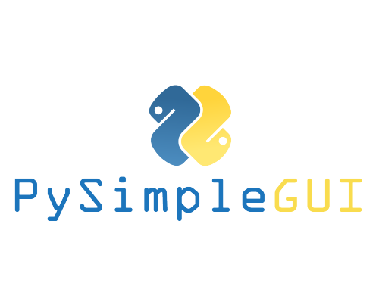
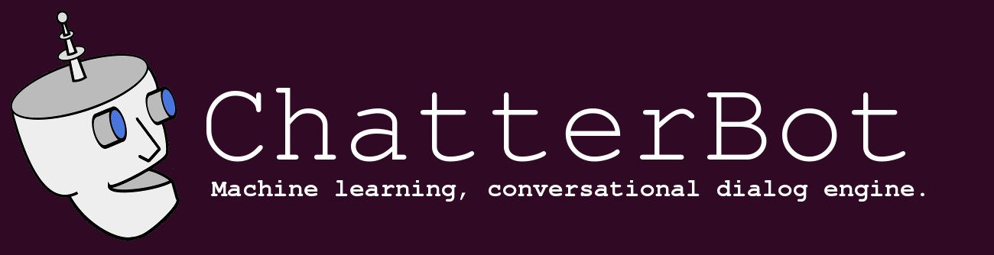
How the bot is built?
PySimpleGUI
gTTS
chatterbot
PySimpleGUI is a python package that transforms the tkinter, Qt, WxPython, and Remi (browser-based) GUI frameworks into a simpler interface.
gTTS (Google Text-to-Speech), a Python library and CLI tool to interface with Google Translate's text-to-speech API.
ChatterBot is a Python library that makes it easy to generate automated responses to a user’s input.

Slide 6
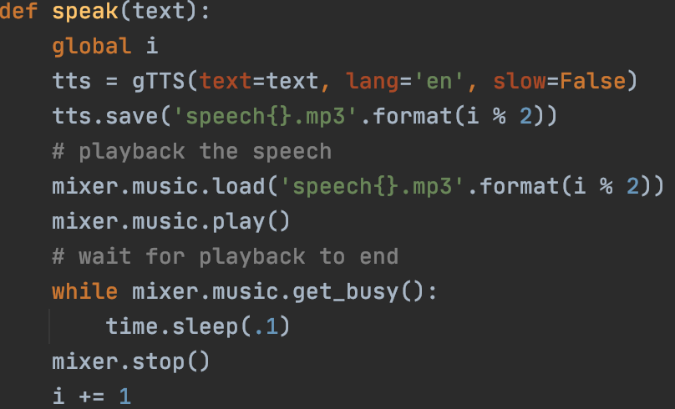
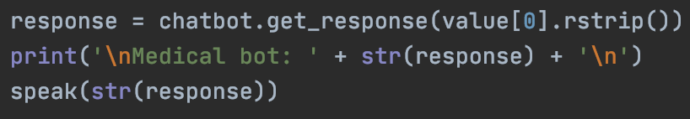
How we made the bot talk:
gTTS
Defined the speak function, pass in the response that is generated by chatterbot, gTTS will take care of it.

Slide 7
Which is better? RCNN? SSD? YOLO?
Faster R-CNN：
SSD：
YOLOv3:
Loss | SoftMax | SoftMax Loss | Logistic loss
Feature extractor | Inception-Resnet | VGG-19 | Darknet-53
mAP | 34.9 | 26.8 (SSD512) | 33 (Yolov3 608)
Overall, RCNN select SVM as feature classifier however SSD and Yolo choose SoftMax. SSD is faster but Yolo achieves a good balances.

Slide 8
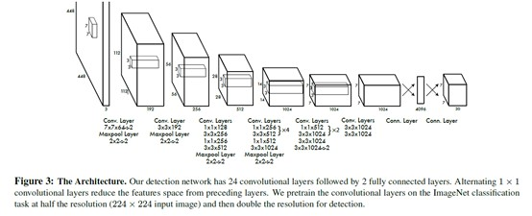
YOLOv3 and YOLO-Fastest
YOLOv3:
From Darknet-53
3 Yolo Layers
200Mb Weights
66Bflops
YOLO-Fastest:
One of the smallest Yolo model
2 Yolo Layers
EfficientNet-lite
1.3Mb Weights
0.23Bflops

Slide 9
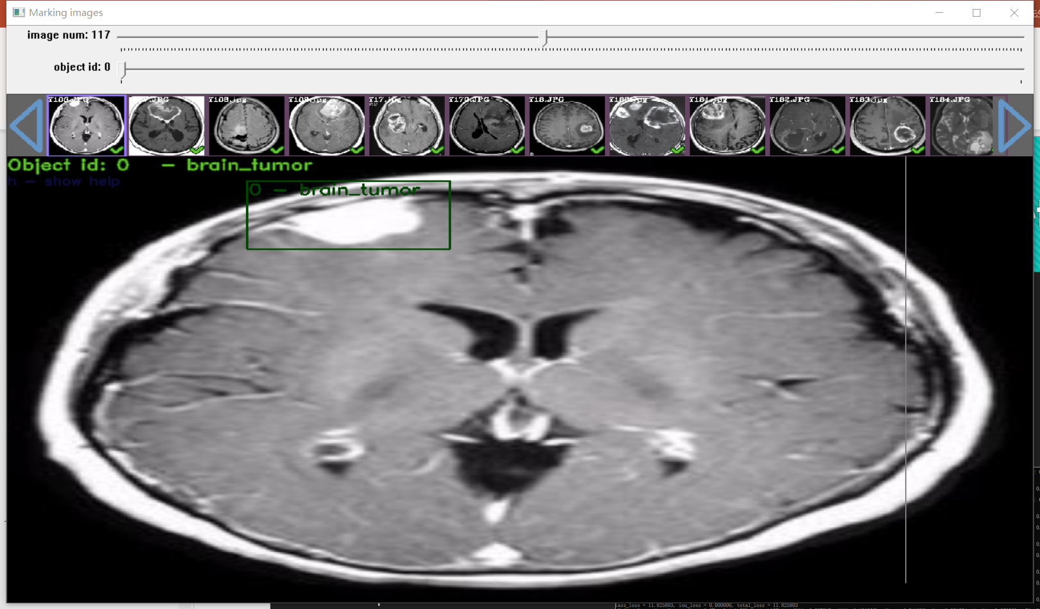
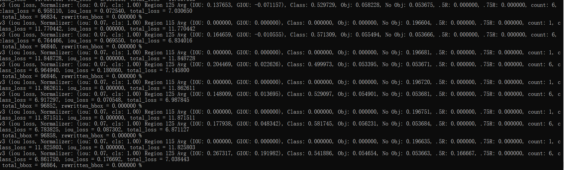
Training YOLO-Fastest Model via Darknet
Make Darknet with CUDA CUDNN off
Label the dataset image by YOLO-Mark
The data and boxes-info files will be generated automatically
Modify the yolo configuration
Start training by “./darknet detector train .data .cfg .conv”
Settings:
Datasets: 250 pics
Classes: 1
Filters: 18
Batch: 64
Subdivisions: 32
max-batches: 6000
steps:4800, 5400
Learning Rate: 0.008
Epochs: 4
Times: 8H 40Min

Slide 10
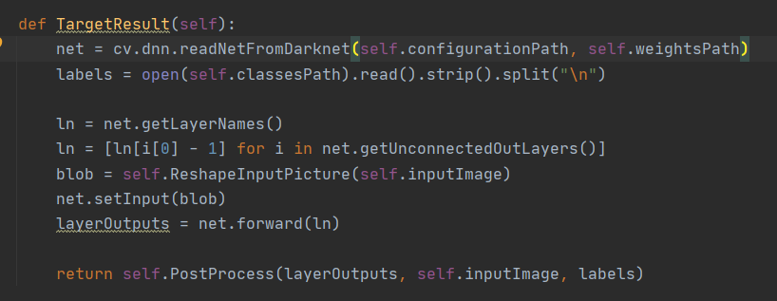
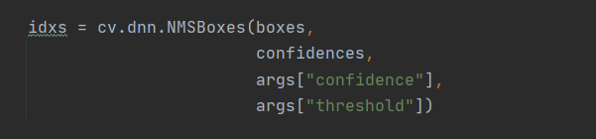
Import pre-trained model into project
OpenCV.DNN
After several hour’s training, we have the Yolo Weights Files. Let’s rebuild the net from configuration and weights files.
Rebuild net
Resize image and get blob
SetInput and Make Forward
Get the output mats
NMSBox

Slide 11
Some Problems
This model size is too small, and the parameters are insufficient
Few training batches
The Yolo model lacks an attention module
Tumor targets have blurred edges and lack of details
Lack of other features
No enough time

Slide 12
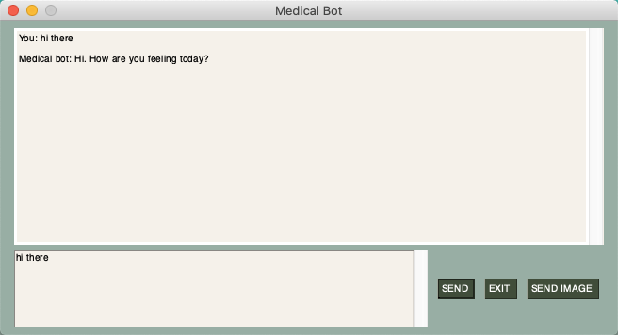
Demo Present

Slide 13

THANK YOU ALL

